Slide 1



Mansfield District Council TSM Survey 2025/26
Chris Elliott
Principal Consultant – Customer Experience
chris.elliott@housemark.co.uk
housemark.co.uk
13th January 2026
housemark.co.uk

Slide 2
2025/26 Report
Tenant Satisfaction Measures (TSMs) were introduced in 2023/24 as a regulatory requirement for all landlords in England. There are 22 TSMs – of which 12 are sourced from a tenant perception survey.
This report provides results for period 2025/26.
The results in this report are based on 659 responses* (*based on TP01 overall satisfaction responses) – collected by combination of telephone (450 completed) and online (209 submitted).
Based on a total of 6,019 properties and the 659 responses received this year the overall margin of error for the survey is +/-3.6% (compliance requiring +/-4%).
As well as the mandatory questions, respondents were also given the opportunity to say in their own words:
Why tenants gave the score they did on TP01 overall satisfaction
How easy or difficult do you find contacting Mansfield District Council housing services?
How can contacting Mansfield District Council be easier?
2

Slide 3
2025/26 Report
Feedback services provider (collecting, generating, and validating the reported perception measures) | Service Insights Ltd
Survey fieldwork date | November / December 2025
Total surveyable population | 6,019
Total sample size achieved (total number of responses) | 659
Statistical confidence required and achieved | Margin achieved +/-3.6% (+/-4.0% required)
Reasons for any failure to meet the required sample size | Not applicable
Collection method | Telephone (450 completed) Online (209 submitted)
Type and amount of any incentives offered | None
Sampling method | Randomised sample through MS Excel randomisation.
Number of tenant households within the relevant population that have not been included in the sample | None
Summary of representativeness of the sample against the relevant tenant population | As the tenant survey responses were considered to be representative of the wider tenant population, weighting was not required (Figures 3 and 4 seen over the page).
Any weighting applied | Weighting was not required for this report.
Questions asked | 12 regulatory TSM questions Qualitative probe on TP01 Ease of contacting Mansfield District Council Qualitative probe on ease
Any other methodological issues likely to have a material impact on the tenant perception measures reported | None
3

Slide 4

TSM Results
4

Slide 5
Executive Summary
Overall Satisfaction
Overall satisfaction is 69.7% (+1.7% on the 2024/25 TSM scores).
TSM Scores
Tenants are most satisfied with being treat fairly and with respect and the safety of the home.
Biggest improvements on last years score include complaint handling and repairs (including speed).
Tenants are least satisfied with approach to handling complaints and listening to views and acting upon them.
Benchmarking
When benchmarked against the national average, all scores are broadly comparable with national and peer group median scores.
Key driver analysis
Keeping the home well maintained, listening to views and acting upon them and safety of the home have strongest impact on overall satisfaction.
5

Slide 6
Sample Data
Age Band | Tenant Profile Count | Tenant Profile Percentage | Survey Profile Count | Survey Profile Percentage
Under 25 | 146 | 2% | 8 | 1%
25-34 | 630 | 10% | 77 | 12%
35-44 | 1038 | 17% | 97 | 15%
45-54 | 943 | 16% | 109 | 17%
55-64 | 1193 | 20% | 147 | 22%
65-74 | 1070 | 18% | 124 | 19%
75-84 | 739 | 12% | 75 | 11%
85 and over | 252 | 4% | 22 | 3%
Unknown | 8 | 0% | 0 | 0%
Tenure | Tenant Profile Count | Tenant Profile Percentage | Survey Profile Count | Survey Profile Percentage
General Needs | 4029 | 67% | 447 | 68%
Extra Care | 37 | 1% | 4 | 1%
Over 55 | 38 | 1% | 4 | 1%
Shared ownership | 16 | 0% | 0 | 0%
Supported | 1899 | 32% | 204 | 31%
6

Slide 7
TSM Scores
Ref | Question (volume of respondents in brackets) | 2025/26 | Previous year (2024/25) | Difference (+/-)
TP01 | Overall satisfaction (659) | 69.7% | 68.0%​ | 1.7%
TP02 | Repairs service overall (447) | 76.1% | 72.9%​ | 3.2%
TP03 | Speed of repairs (444) | 75.0% | 69.1%​ | 5.9%
TP04 | Home is well-maintained (631) | 70.8% | 71.2%​ | -0.4%
TP05 | Home is safe (630) | 79.4% | 75.6%​ | 3.8%
TP06 | Listens to views and acts (566) | 62.7% | 59.7%​ | 3.0%
TP07 | Keeps tenants informed (597) | 69.2% | 65.7%​ | 3.5%
TP08 | Treats tenants fairly and with respect (618) | 79.3% | 76.8%​ | 2.5%
TP09 | Complaint handling (124) | 41.9% | 33.3%​ | 8.6%
TP10 | Communal areas are clean and well-maintained (194) | 63.4% | 60.0%​ | 3.4%
TP11 | Contribution to neighbourhood (570) | 65.8% | 64.5%​ | 1.3%
TP12 | ASB handling (440) | 57.3% | 55.0% | 2.3%
7

Slide 8
TP01 (Overall Satisfaction) 25/26 vs Previous Year
TP01 score by method of data collection:
Telephone (450) 78.2%
Online (209) 51.2%
8

Slide 9
TP01 (Overall Satisfaction) trend over time
9

Slide 10
TP01 (Overall Satisfaction) by age
10

Slide 11
TP01 (Overall Satisfaction) by ethnicity and sex
11
Note – Not all ethnicity segments had responses collected so are omitted from the chart.

Slide 12
TP01 (Overall Satisfaction) by property type and needs category
12

Slide 13
TP01 – Overall Satisfaction comment themes in here
Analysing comments from tenants that score ‘very satisfied’ with their overall satisfaction, overall themes consider:
Responsiveness and Timeliness
This is the standout driver of overall satisfaction. Phrases such as ”come quickly” and “straight away” appear frequently and consistently. Fast response times lowers stress, prevents small issues from becoming big ones, and builds trust that Mansfield District Council ‘has their back’. This is particularly impactful for elderly and vulnerable tenants.
Repairs and Maintenance
Beyond speed, tenants praise that repairs get fixed properly, damp causes are identified and resolved, leaks sorted, boilers replaced, and the home left tidy. Quality of the actual fix matters.
A quick visit that doesn’t solve the problem is worse than a slower but more effective fix. First‑time resolution reduces repeat visits, cost, and frustration.
Staff attitude & professionalism
Words like polite, friendly, helpful, considerate, understanding, professional are common. Tenants appreciate being treated with respect and having things explained clearly (e.g., repair staff making tenants feel comfortable about the state of their home). Housing officers and wardens receive specific praise. Attitude amplifies technical quality—politeness and empathy shape the entire experience and drive recommendations.
Reliability & communication
Tenants value that Mansfield District Council does what it says, keeps appointments, and responds when contacted. Where updates are given (“keep us up to date”), they are noticed and appreciated. Reliability is the glue between speed and quality. Even when works can’t be done immediately (e.g., parts or scaffolding needed), frequent, honest updates sustain confidence.
13

Slide 14
TP01 – Overall Satisfaction comment themes in here
Analysing comments from tenants that score ‘very’ and ‘fairly dissatisfied’ with their overall satisfaction, overall themes consider:
Delays & Unfinished Repairs
Tenants’ core frustration is the time it takes to get things done, from weeks to years, and jobs left incomplete (“waiting 3 years for new windows,” “repair left not completed for over a year”), which undermines trust and increases risk when problems escalate (e.g., leaks turning into ceiling damage). The perceived pattern centres around inspections or promises without delivery.
Property condition & safety issues
Several tenants cite damp/mould, leaks, asbestos, structural cracks, unsafe doors/gaps, flooding, rats, and cold homes (“bathroom full of mould… not repaired,” “front door has a 12‑inch gap”). These are high risk, health and safety critical faults; delays here disproportionately damage satisfaction and can create legal exposure.
Poor quality repairs
Even when attendance is timely, many tenants' report shoddy or temporary fixes and repeated call‑backs (“no repair done to a satisfactory level… call about the same repair too many times,” “all the work… just a bodge”). This inflates cost, rework, and frustration.
Communication & follow‑up failures
Tenants frequently feel unheard or left in the dark “don’t listen,” “no response,” “not get back,” “fobbed off,” “lied” are frequent keywords and phrases and describe inspections or surveys with no visible next step. Communication breakdown amplifies the impact of delays/quality issues and drives complaints.
Contractors & accountability
A vocal subset cites poor contractor standards, damage caused during works, and serious conduct concerns, contrasting them with better experiences from Mansfield District Council staff. This erodes confidence and can create safeguarding risks.
14

Slide 15
TP01-TP12 Spread of Scores
15

Slide 16
TP02 / TP03 - Repairs
TP01 Score for those not reporting a repair 73.2%
TP01 Score for those reporting a repair 68.6%
TP01 Overall satisfaction score for respondents who are very dissatisfied with overall repairs service is 15.6%, whereas those who are very satisfied with overall repairs service is 89.4%
16

Slide 17
TP09 – Complaint Handling
TP01 Score for those who have not made a complaint 75.0%
TP01 Score for those who have made a complaint 55.2%
TP01 Score for those who very dissatisfied with approach to complaint handling 41.7%
TP01 Score for those who very satisfied with approach to complaint handling 75.0%
17

Slide 18
TP10 – Communal Areas
TP01 Score for those who don’t live in a home with communal areas 70.3%
TP01 Score for those who live in a home with communal areas 74.4%
TP01 Score for those who very dissatisfied with communal areas 41.4%
TP01 Score for those who very satisfied with communal areas 87.3%
18

Slide 19
Key Driver Analysis / Benchmarking
19

Slide 20
Key Driver Analysis
Customer satisfaction offers an excellent insight into tenant’s perspectives and their experiences with services. Key driver analysis takes this one step further by exploring the relationship between specific aspects and overall satisfaction.
Correlation analysis looks to identify a relationship between individual TSM questions (TP2 – TP12) with the overall satisfaction question (TP01).
The correlation determines a value between 0 and +1. The larger the number, the strong the impact on overall satisfaction. Typically, factors that have a correlation factor of 0.5 has a relatively large impact on overall satisfaction. Factors of 0.7 and above are regarded as having a very strong impact on overall satisfaction.
20

Slide 21
Key Driver Analysis
21

Slide 22
Benchmarking TP01-TP06
22

Slide 23
Benchmarking TP07-TP12
23

Slide 24
Additional Questions
24

Slide 25
Ease of contacting Mansfield District Council services
There is a strong correlation with ease of contacting and overall satisfaction.
25

Slide 26
How can Mansfield District Council be easier to contact?
All respondents were asked how Mansfield District Council can become easier to contact. The following key themes were identified:
More call handlers / staff
Tenants most often ask for more people answering phones to reduce pressure on the switchboard and get through faster (e.g., “More staff in call centre… waiting times are about 45 mins,” “More people on the phone,” “Have more staff to answer the phone”). The impact is straightforward: understaffing drives long waits, repeat dialling, and drop‑offs.
Best Practice: Increase peak‑time coverage, enable skills‑based routing so the first person can help, and publish a simple “when we’re busiest/quietest” banner on the website to nudge call timing. Track: average speed of answer (ASA), abandon rate, and agent occupancy by hour to prove the queues are shrinking.
Reduce call waits / answer & callbacks
Alongside staffing, tenants want shorter waits and reliable callbacks—they mention 45‑minute queues, being cut off, full voicemail, and not getting called back “when they say they will.” This compounds frustration, especially when chasing repairs.
Best Practice: Promise and meet a callback SLA (e.g., within 2 hours for non‑urgent, same day for urgent), auto‑acknowledge missed calls/voicemails, and show position‑in‑queue with an estimated wait. Track: % callbacks within SLA, voicemail backlog/age, and repeat‑contact rate for “chasing.”
Simpler routing / clearer contact points
Many find contact confusing “not clear where you need to call,” getting passed around, or stuck at the switchboard and some note the IVR/music experience as off‑putting.
Best Practice: Consider a clear ‘single front door’ with a short, plain‑English menu; publish a ‘Who to contact’ page (housing repairs vs. housing officer vs. revenues) and keep it aligned with IVR wording; and allow warm transfers that stick (don’t bounce people). Track transfers per resolved case, % resolved at first touch by line of business, and IVR opt‑out usage.
Improve online & digital options
Some tenants prefer digital first, but say the website/online system isn’t fit for purpose or emails aren’t answered (“online would be better than calls,” “website not fit for purpose,” “online system doesn’t work,” “check emails regularly and respond”).
Best Practice: Make the online route truly viable: streamline forms (mobile‑first), add webchat for quick triage, auto‑acknowledge emails with ticket numbers and expected response times, and surface case status online so tenants can track progress without phoning. Track digital completion rate, email response‑time SLA performance, deflection rate from phone to webchat/portal.
26

Slide 27
Conclusions / Next Steps
27

Slide 28
Going Beyond Compliance – Maximising Feedback
1. Research
2. Feeding back results internally
3. Creating an action plan
4. Implementing the plan – ‘doing stuff’
5. Feeding results back externally (‘you said…we did’)
“The smallest of actions is better than the greatest of intentions”
Any kind of ongoing research is cyclical in nature. But it’s what you do (or not as the case may be) in between the research that can make a profound difference to your scores.
Research is the easy part – that’s why most organisations undertake customer feedback. The next steps are where the challenge exists:
Only half of organisations feedback results internally.
A third of organisations create an action plan.
A quarter actually ‘do stuff’ – implement the action plan.
1 in 10 organisations effectively feedback results externally.
28

Slide 29
Going Beyond Compliance – Areas for Improvement
Low Impact / Low Satisfaction(Givens)
High Impact / Low Satisfaction (Enhancers)
High Impact / High Satisfaction (Maintain)
Focus for Improvement
All research is insightful, but for our purpose we also want the research to be actionable.
In order to deliver change, the survey should help provide focus by identifying a small number of areas to take action:
Relative low impact / low satisfaction (e.g. Complaint handling, ASB handling).
High impact / low satisfaction (e.g. Listening to views and acting upon them).
High impact / high satisfaction (e.g. repairs, including keeping home well maintained)
Also consider benchmarking gaps – where the largest gaps exists when compared against high scoring peers (e.g. complaints, repairs, listening to views and acting).
29

Slide 30
Areas for Improvement - Complaints
High impact / low satisfaction (e.g. Complaint Handling)
What it means: These are critical areas where poor performance strongly influences overall tenant satisfaction and regulatory compliance.
Why it matters: Complaint handling is a high-stakes process—failures here amplify dissatisfaction and risk non-compliance with TSM standard, whereas tenants that are highly satisfied with complaint handling demonstrate higher overall satisfaction than tenants who have not even made a complaint.
Action approach:
Root cause analysis: Identify why complaints are poorly handled (speed, empathy, resolution quality).
Process redesign: Implement clear SLAs, escalation paths, and staff training.
Proactive communication: Keep tenants informed throughout the complaint lifecycle.
Measure improvement: Track resolution times and satisfaction post-complaint.
 | Best Practice Approach
Follow Ombudsman Code | Two-stage process with strict timescales.
Accessibility | Multiple channels (phone, email, online) and clear definitions.
Empathy & Culture | Treat complaints seriously, embed respect and dignity.
Case Management | Named handler, regular updates, robust tracking system.
Root-Cause Analysis | Identify systemic issues and embed learning into service improvement.
Transparency & Reporting | Annual self-assessment and publish performance data.
30

Slide 31
Areas for Improvement - ASB
Relative low impact / low satisfaction (e.g. ASB handling, Maintenance of Communal Areas).
What it means: These are services that tenant's rate poorly but are not considered highly influential on overall satisfaction.
Why it matters: While these areas may not drive overall satisfaction significantly, persistent low scores will erode trust and damage reputation or compliance.
Action approach:
Quick wins: Improve communication and visibility of actions taken (e.g., updates on ASB cases or communal cleaning schedules).
Efficiency focus: Streamline processes without heavy investment since impact is limited.
Monitor trends: Ensure these areas don’t deteriorate further, as they can become pain points.
 | Best Practice Approach
Policy & Prevention | Clear ASB policy, tenant education, actionable early-intervention steps
Partnerships | Multi-agency collaboration and intelligence-sharing
Victim Support | Risk-assessed, supported and informed victims
Case Management | Trackable case files, SLAs, incident logs
Enforcement Options | Graduated tools leading up to legal enforcement
Communication | Structured updates, diaries, transparency
Monitoring & Review | Data-led audits, regulatory reporting
Training & Leadership | Staff-trained & strategic oversight at governance levels
31

Slide 32
Areas for Improvement – Repairs (inc keeping home maintained)
High impact / high satisfaction (e.g. repairs, including keeping home well maintained)
What it means: These are strengths that significantly influence overall satisfaction.
Why it matters: Repairs are a major driver of tenant trust and perception of service quality. Maintaining high performance here protects overall satisfaction scores.
Action approach:
Sustain excellence: Continue investing in repairs and maintenance processes.
Leverage as a differentiator: Showcase strong performance in communications and annual reports.
Innovation: Explore digital tools for scheduling and updates to enhance convenience.
Prevent decline: Monitor KPIs closely to avoid slippage in this critical area.
 | Best Practice Approach
Clear Repairs Policy | Define emergency, urgent, and routine categories with timelines.
Accessible Reporting | Multiple channels and 24/7 emergency contact.
Efficient Scheduling | Triage system, real-time updates, convenient appointments.
Compliance | Gas, electrical, and fire safety standards.
Preventative Maintenance | Planned programmes to reduce emergency repairs.
Performance Monitoring | KPIs like first-time fix rate, completion times, tenant satisfaction.
Sustainability | Use energy-efficient materials and reduce waste.
32

Slide 33
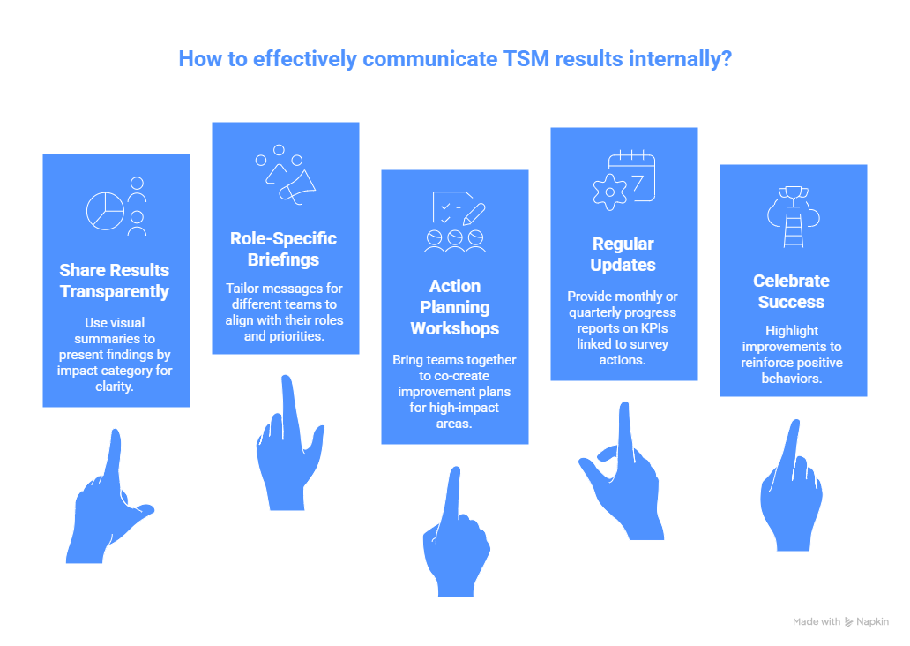
Going Beyond Compliance – Communicating TSM’s Internally
33

Slide 34
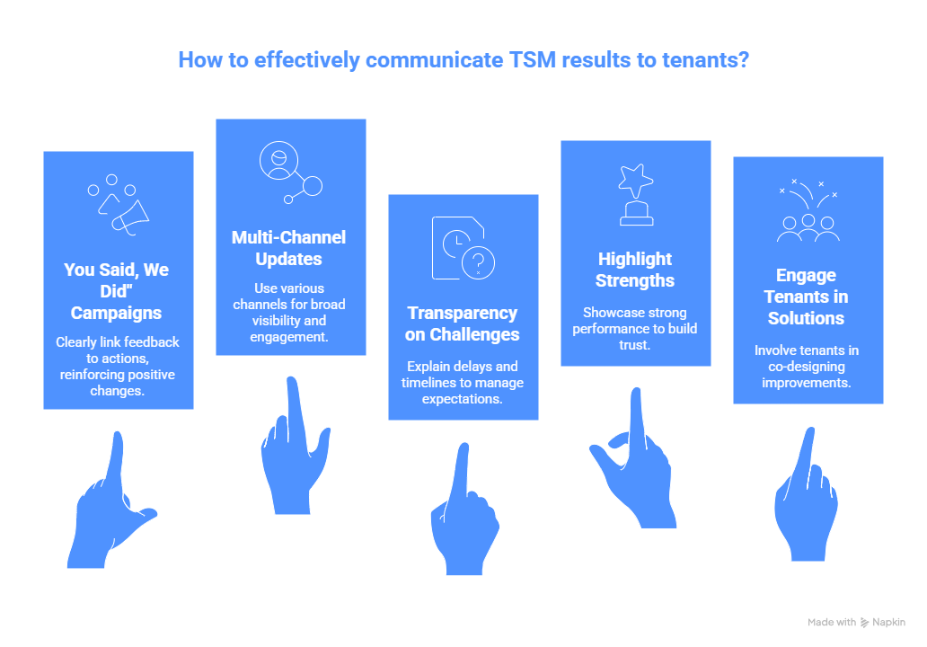
Going Beyond Compliance – Communicating TSM’s Externally
34

Slide 35
Summary / Next Steps
Overall Satisfaction
Overall satisfaction is 69.7% (+1.7% on the 2024/25 TSM scores).
TSM Scores
Tenants are most satisfied with being treat fairly and with respect and the safety of the home.
Biggest improvements on last years score include complaint handling and repairs (including speed).
Tenants are least satisfied with approach to handling complaints and listening to views and acting upon them.
Benchmarking
When benchmarked against the national average, all scores are broadly comparable with national and peer group median scores.
Key driver analysis
Keeping the home well maintained, listening to views and acting upon them and safety of the home have strongest impact on overall satisfaction.
Areas of Focus
Using the data collected, we would recommend the following areas to be where focus on improvements should be placed:
Complaint handling
ASB handling
Repairs experience (including general maintenance of the home)
Engagement (including listening to views and acting, and keeping tenants informed)
Moving beyond compliance
Taking action
Communicating results and actions internally and externally
35

Slide 36
Housemark and Service Insights Ltd
At Housemark we offer a wider range of service market research and service design services, including:
Service Research
Phone, email, SMS, postal, and face to face surveys, anywhere in the UK
Perception surveys
Transactional surveys
Bespoke surveys
Employee surveys (employee satisfaction and niche/ bespoke topics)
Customer satisfaction impact reviews
Service Design
Focus groups & in-depth interviews
Customer journey maps
Co-creation personas, idea generation, validation and development

Slide 37
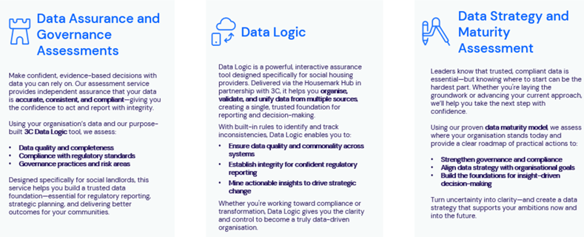
Housemark and 3C: The Trusted Authority in Social Housing Data Excellence
Housemark and 3C lead the way in transforming data into a strategic asset for social housing providers across the UK. Our sector-specialist consultancy and tools turn fragmented, inconsistent data into a single, trusted source of truth, empowering you to make confident decisions, meet regulatory demands, and deliver better outcomes for your communities.

Slide 38

Housemark and Ad Esse: Specialists in helping landlords deliver sustainable performance improvement
Ad Esse (https://www.ad-esse.com/) are a Housemark Hub Partner with a strong track record of helping social housing landlords improve operational performance across key areas such as repairs, complaints, voids, and service charges.

Slide 39
Mansfield District Council TSM Survey 2025/26
Chris Elliott
Principal Consultant – Customer Experience
chris.elliott@housemark.co.uk
housemark.co.uk
13th January 2026
housemark.co.uk

