Slide 1
Planning and Regeneration Update
Martyn Saxton
Head of Planning & Regeneration

Slide 2
Local Plan
Examination on Publication Draft May 2019
Consulted on Modifications - Autumn 2019
Adopt March 2020
Gypsy & Traveller & Travelling Showpeople SPD
Consultation on 15 potential sites Aug / Sep 2019
Regulation 19 Consultation – preferred sites Spring 2020

Slide 3
Town Centre Master Plan
- aim to revitalise the town centre/visitor economy
- links to FHSF & Towns Fund
- evidence gathering –retail/parking etc
Future High Street Fund
- up to £25m from MHCLG - passed Stage 1
- investment in physical infrastructure
- acquisition of land
- improvements to transport access
- support for COU for housing
- draft submission January 2020
- final submission due April 2020

Slide 4
Towns Fund
announced 6th September 2019
£25m allocated (non-competitive)
‘focus on improved transport, broadband connectivity, skills and culture
funding aimed at areas with;
lower income population in towns
below national average productivity
low skills attainment
‘Readiness Checklist’ submitted Dec 2019
awaiting further details

Slide 5
Town Hall Refurbishment
£1.4m scheme – under budget
completion TODAY
2 offices units let Halo
retail unit under offer
4 remaining units to be let

Slide 6
Mansfield Townscape Heritage Project
£850k National Lottery Heritage Fund
improvements/Renovate properties on Leeming Street/Market Place/Stockwell Gate
grant panel set up
launched on 3rd September 2019
ends 2024
third of properties in project area now active

Slide 7
Business Support Available
1-2-1 business advice/planning
1 stop shop
Grant and investment funding
Commercial property search
Access to business training & masterclasses

Slide 8
Support to access skills and employment services
Subscriptions to local businesses news and events
Access to local business networks
Account management and future assistance

Slide 10
Smart City – An Essential Enabler for Enhanced Urban Living Andy Dean Programme Manager, Smart Campus andy.dean@ntu.ac.uk 07920 563820

Slide 11
Content
What is a Smart City
Why bother creating Smart Cities
Smart Cities -Hype verses reality
The importance of digital connectivity
Smart City, some typical features
Wayfinding
Smart Parking
Location Based Services
Energy storage
Urban farming
Smart City example - Glasgow
Smart City - Vision of a utopian solution

Slide 12
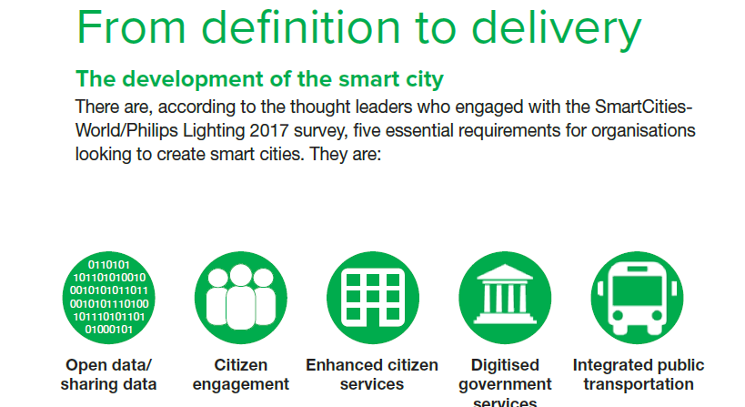
What is a SMART CITY?

Slide 13
Benefits of a Smart City – Reason to Bother!
More effective, data-driven decision-making.
Enhanced citizen and government engagement.
Safer communities.
Reduced environmental footprint.
Improved transportation.
Increased digital equity.
New economic development opportunities.
Efficient public utilities.
Improved infrastructure.
Increased workforce engagement

Slide 14
Smart City - Hype vs Reality
A city is not smart simply by installing a number of technology based features.
Connectivity of the technologies and features is what makes it smart and enables….
Key decisions based on multiple data sources (Eg. energy use)
Increased efficiency across many of the functions (Eg. traffic management)
Benefits to citizens, based on real time data about facilities and services.
It’s about understanding real time demand for services and flexing supply to suit the demand.
Challenges
Multiple stakeholders with different needs
Who controls the power and decision making
Citizen engagement
Technology adoption

Slide 15
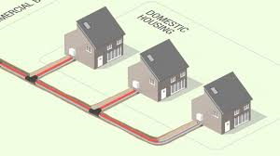
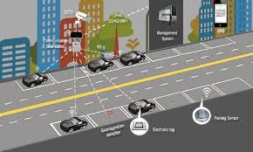
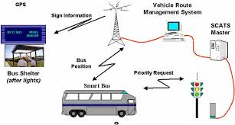
The Importance of Digital Connectivity
Smart Cities are in early evolution, with strong ongoing debates regarding definition.
What is becoming increasingly clearer is that CONNECTIVITY of features and technologies is paramount and key to making a city truly SMART.
A city with a set of implemented functional technologies, may be a high tech city, but it is not necessarily SMART……

Slide 16
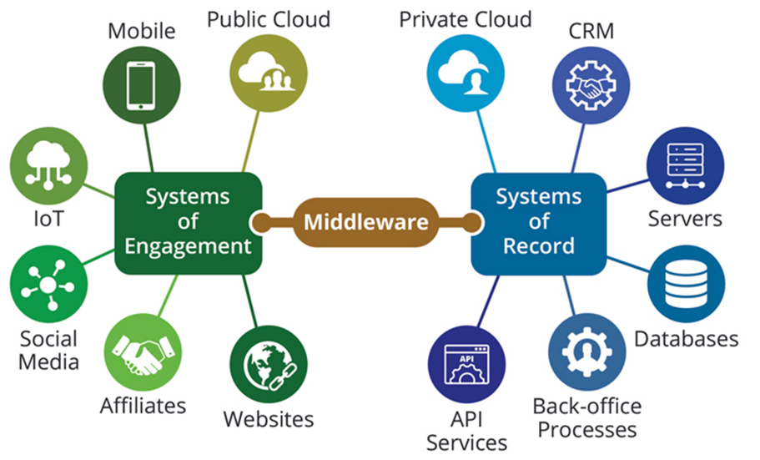
The Importance of Digital Connectivity
According to thought leaders, it is the use of captured data that enables decisions, to enhance city living that makes a city truly SMART.
Enablers – IoT, Low Power Wide Area networks, as well as 5G, that allow technologies based on a multitude of digital platforms to communicate.

Slide 17
SMART CITY, Some Typical Features
Traffic management
Building management systems
Movement detection
Location based services
Rubbish collection
Urban farming
Energy distribution
Smart parking
Air quality management
Energy storage
Driverless electric vehicles
District heating
Wayfinding
Smart retail
Renewable energy
Centralised operations

Slide 18
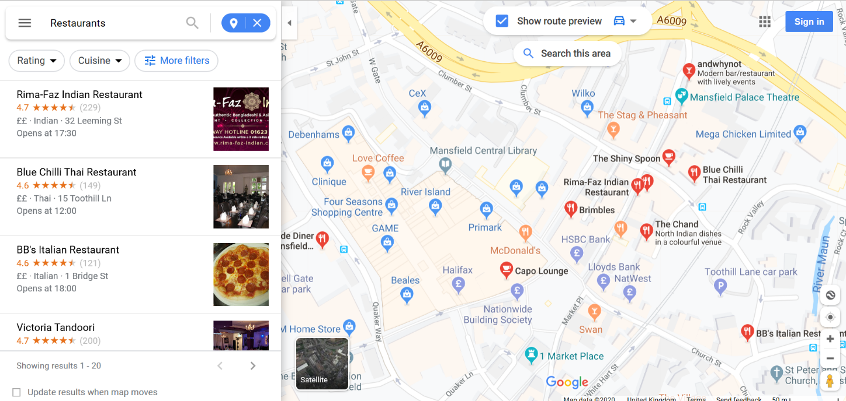
Wayfinding
Google maps gives you information…….but it is not connected

Slide 19
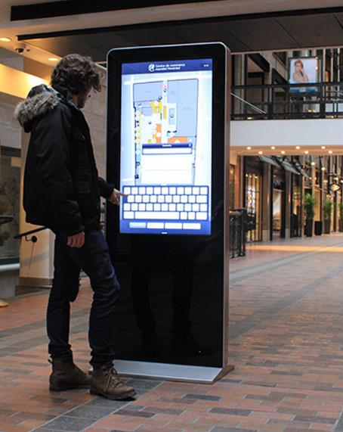
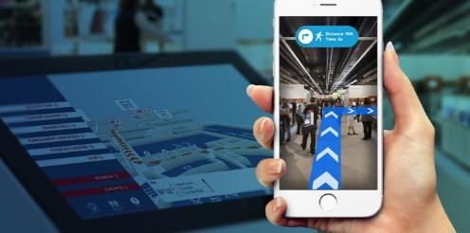
Smart City Features - Wayfinding
Wayfinding gives you detailed real time information
Where buildings etc are.
Rooms in buildings.
Assets in rooms.
Broken lifts.
Event based information.
Options based routing
Eg. Avoiding stairs.
Eg. Minimising outside exposure.

Slide 20
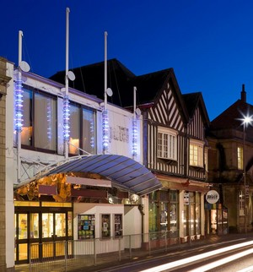
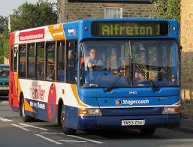
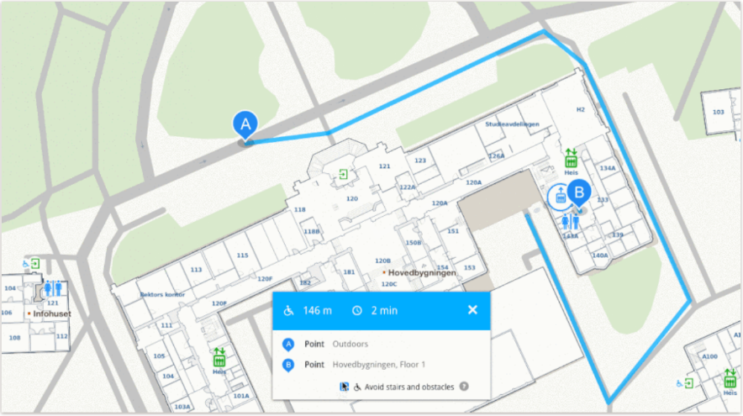
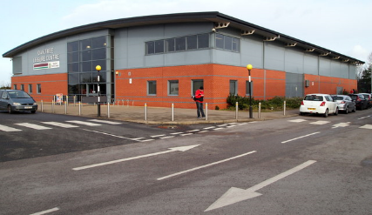
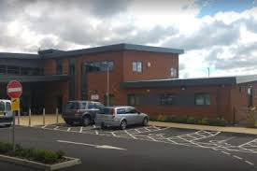
Smart City Features - Wayfinding
Wayfinding gives you detailed information…….and it is connected.
Service providers can be linked to the Wayfinding platform to give detailed and real time information.

Slide 21
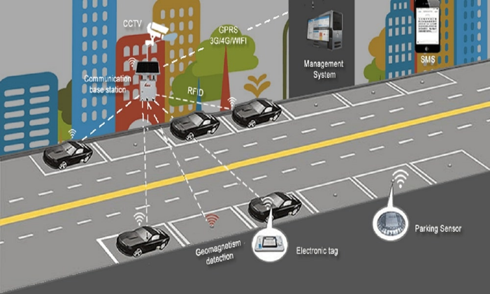
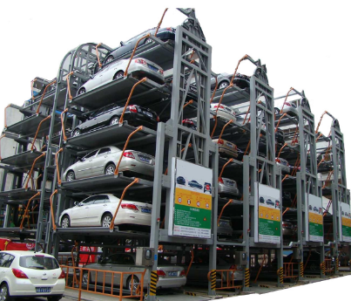
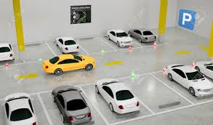
Smart City Features – Smart Parking
On street solutions
Carousel solutions
Multi-storey solutions
Real time availability
Pre-booking
Space signage

Slide 22
Smart City Features - Location Based Services
Providing citizens with detailed real time information:
Parking.
Transport.
Appointments.
Retail and leisure services.
Relies on service providers connecting to the wayfinding platform. Simple and cost effective.
Citizens can opt into preferred services.

Slide 23
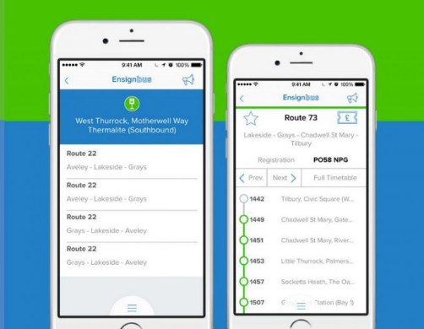
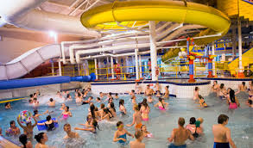
Smart City Features - Location Based Services

Slide 24
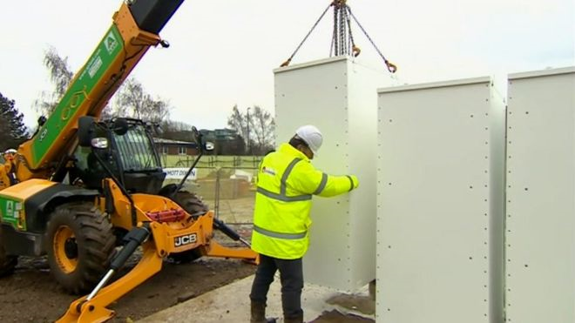
Smart City Features – Energy Storage
‘2018. What is thought to be Europe's largest community energy battery has been lifted into place in Nottingham’.
The two-megawatt-hour battery is part of a renewable energy network in a 500-home development in the Trent Basin.
Solar panels, heat stores and ground source heat pumps will supply power at the site which is 30% cheaper than normal.

Slide 25
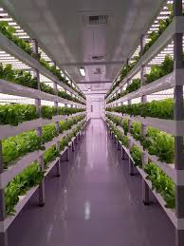
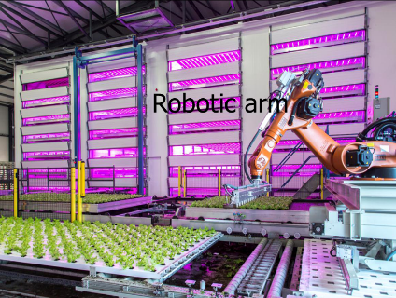
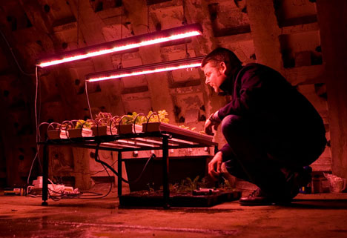
Smart City Features – Urban Farming
Vertical ‘multi storey’ farming solutions, increased yield per m2 of space
Pick ‘n’ place robots for harvesting
Use of ‘dead space’

Slide 26
Smart City Example - Glasgow
2013, Glasgow won £24m from the Technology Strategy Board (now known as Innovate UK) to explore innovative ways to use technology and data to make life in the city safer, smarter and more sustainable.
Glasgow has been developing a series of initiatives to showcase the exciting potential offered by smart city technology, exploring ways to harness the power of data and technology to make the city a better place to live, work and play.
Areas of Focus:
Transport
Health
Energy
Public safety

Slide 27
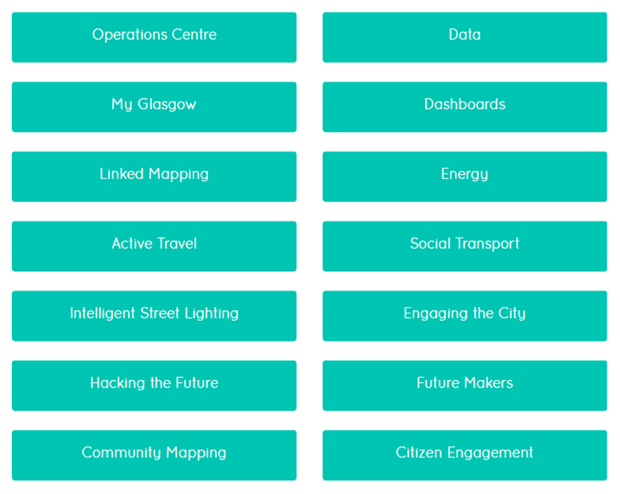
Smart City Example - Glasgow

Slide 28
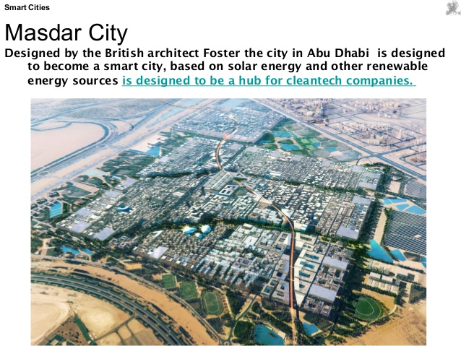
Smart City - Vision of a Utopian Solution
Masdar City is one of the world’s most sustainable urban communities. Developing as an alternative to oil based energy, it’s a low-carbon development made up of a rapidly growing business zone, focused on clean-tech and residential neighbourhood with restaurants, shops and public green spaces.
Desert location next to Abu Dhabi City
Pedestrianised areas
Driverless vehicles
Zero carbon (surrounded by wind farms and
solar farms)

Slide 29
Smart City – An Essential Enabler for Enhanced Urban Living Andy Dean Programme Manager, Smart Campus andy.dean@ntu.ac.uk 07920 563820

Slide 30
Highway and Transport smart investment
Pete Mathieson , Team Manger Development and Partnerships

Slide 31
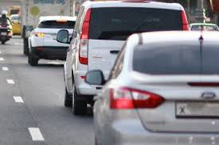
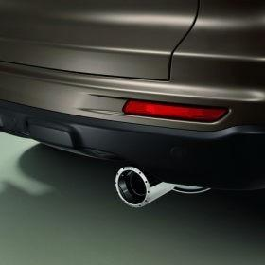
Highway and Transport smart investment
Highway Authority and Local Transport Authority
Investment is guided by Local Transport Plan , Council Plan and Place Plan
Council consulted by Local Planning Authorities to manage impact of development
Key objectives
Promoting growth and creating Jobs - Growth corridors
Congestion management : Congestion costs UK economy £8bn per year
Air quality improvements : Air quality costs UK economy £5.3bn per year
Presentation title

Slide 32
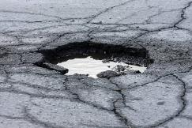
Highway and Transport smart investment
Capital maintenance funding *Indicative allocations still subject to confirmation £m
Highway capital maintenance (DfT allocation) £12.006
Additional County Council capital allocation for road maintenance £3.018
Highway capital maintenance (DfT Incentive Fund allocation)* £2.501
Highway maintenance (DfT Pothole Fund allocation)* £1.000
Flood alleviation and drainage (County capital allocation) £0.900
Street lighting renewal (County capital allocation) £1.000
Total funding available for capital maintenance improvements £20.425
Integrated transport funding £m
Integrated transport block allocation £4.416
Additional County Council capital allocation to address congestion £0.750
Additional County Council capital allocation for road safety £0.350
County Council allocation for enhanced rail services £0.055
Total funding available for integrated transport improvements £5.571

Slide 33
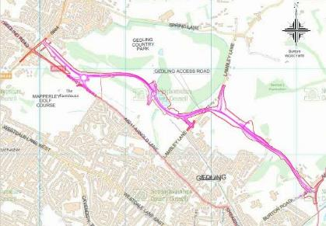
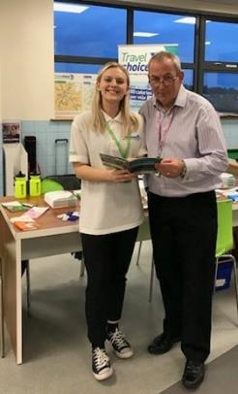
Highway and Transport smart investment
Externally funded schemes £m
Gedling Access Road £25.421
Southwell Flood Risk Alleviation scheme (figure includes £500k contribution from the County Council)£ 1.000
Salix street light fund £ 1.100
Total external funding available for specific improvement schemes £27.521
Revenue funding £m
Traffic management revenue £0.525
Public health reserves (travel planning) £0.165
Total external funding available for specific scheme £ 0.690

Slide 34
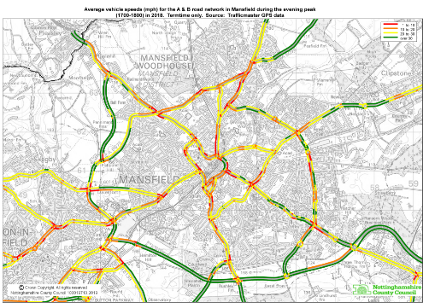
Highway and Transport smart investment
Future studies
Mansfield to Toton HS2 hub public transport connection.
A611 improvements
A38 improvements
A617 MARR resurfacing
A60 Nottingham Rd/Park Lane

Slide 35
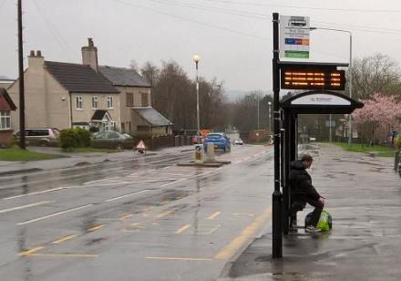
Highway and Transport smart investment
Embracing latest technology to manage network
Modern Urban Traffic Control Centre with multiple junctions SCOOT or MOVA operated to minimise journey time delays for Private and public transport .
Car park management systems to inform users of where spaces are available to reduce congestion and air pollution.
Harvesting data from users to understand Origins and destinations to inform investment decisions- Traffic master data , smartcard data etc
Smart monitoring of highway network
Real time passenger information : 100% coverage by Autumn 2020
Info hubs at Kings Mill and bus station
AVL Traffic Light priority : To be rolled out to ensure reliable and punctual public transport
On bus Audio and next stop information . Rollout of Wi-Fi and USB charging points on Public transport

Slide 36
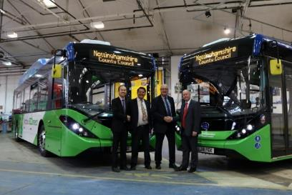
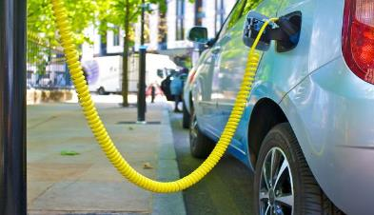
Highway and Transport smart investment
EMV bankcard ticketing for public transport ; Stagecoach and trentbarton so far with others to follow in the future .
Smartcard ticketing also available for those who choose to and on mobile devices.
Improved public transport information and ticketing information by 2021/22
Berry Hill development : Fully electric bus to be introduced in 2021 with charging infrastructure.
EV charging : For Cars and Light Good vehicles.

Slide 37
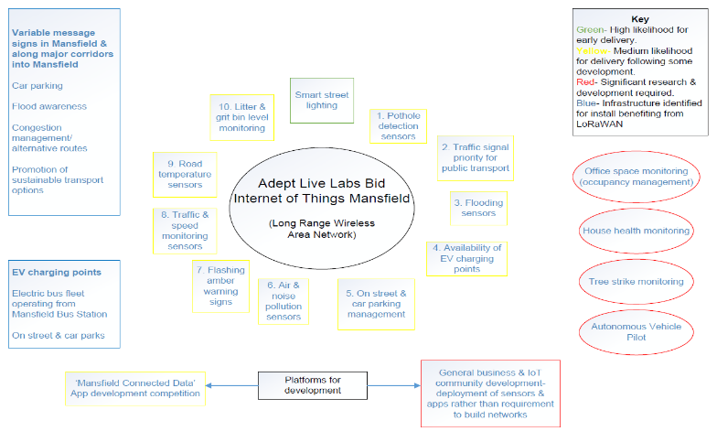
Highway and Transport smart investment
Future opportunities
AV technology using 5G infrastructure to improve access to business
Future High Street Fund
Govt funding for Road investment incl. PT measures
Demand Responsive Transport and Total Transport solutions
Electric Bus towns
ADEPT LoRAWAN incl

Slide 38
Highway and Transport smart investment
Any questions?

Slide 39
Delivering Next Generation Access to Robin Hood County Through Public/Private Partnership
Ceren Clulow

Slide 41
OUR CHALLENGES
1
2
3
Street works
New build houses
Wayleaves

Slide 42
LEGISLATIONS and FURTHER INFORMATION
Telecommunications Infrastructure (Leasehold Property) Bill 2019-20 https://services.parliament.uk/Bills/2019-20/telecommunicationsinfrastructureleaseholdproperty.html
Street Works Toolkit https://www.gov.uk/government/publications/framework-for-uk-fibre-delivery-street-works
Consultation for Development rights to support the deployment of 5G
https://www.gov.uk/government/consultations/proposed-reforms-to-permitted-development-rights-to-support-the-deployment-of-5g-and-extend-mobile-coverage
Electronic Communications Code https://www.ofcom.org.uk/phones-telecoms-and-internet/information-for-industry/policy/electronic-comm-code
Openreach - How to register your development for broadband https://www.openreach.com/fibre-broadband/fibre-for-developers/registering-your-site
Virgin Media - New Build Developer's Guide
https://www.virginmedia.com/lightning/network-expansion/property-developers

Slide 43
The Big Build
It’s a BIG job!
Ceren Clulow
Ceren.Clulow@nottscc.gov.uk

Slide 44
Smart places
David Singleton

Slide 45
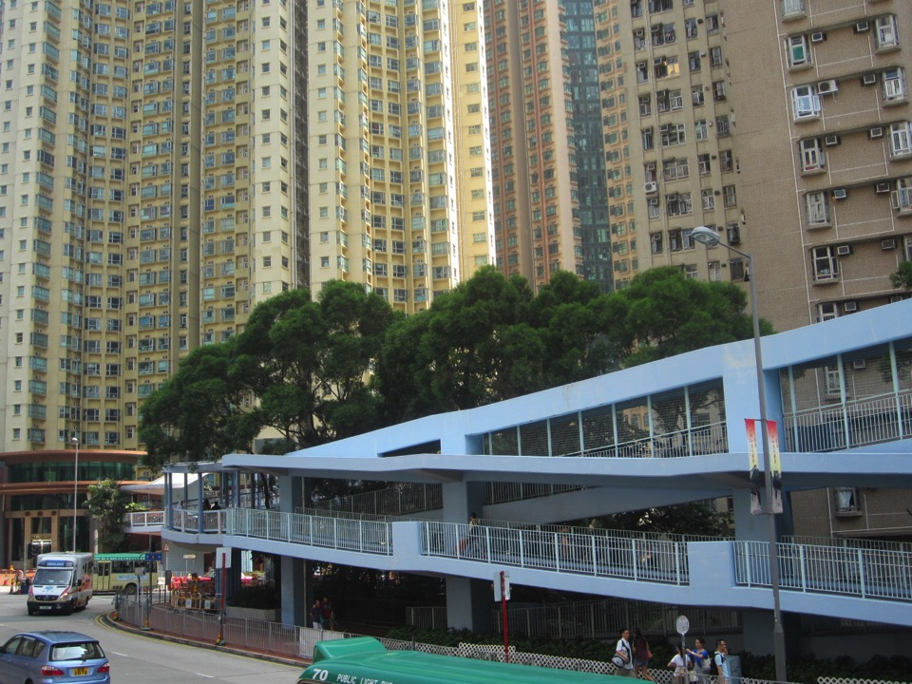

Slide 46
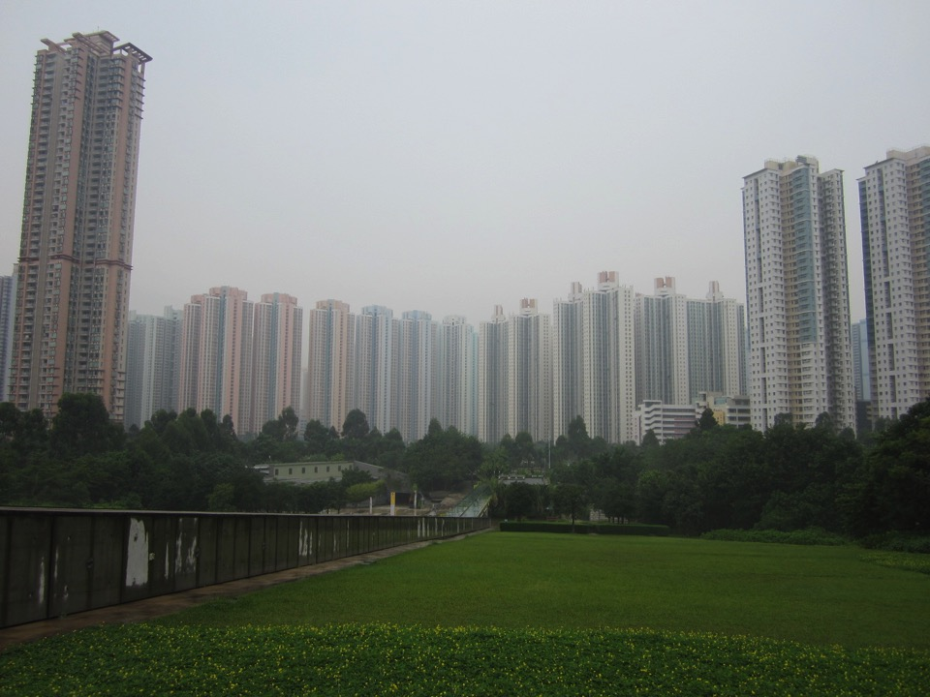

Slide 47
Smart = clever

Slide 48
Smart =
where you’d want to live

Slide 49
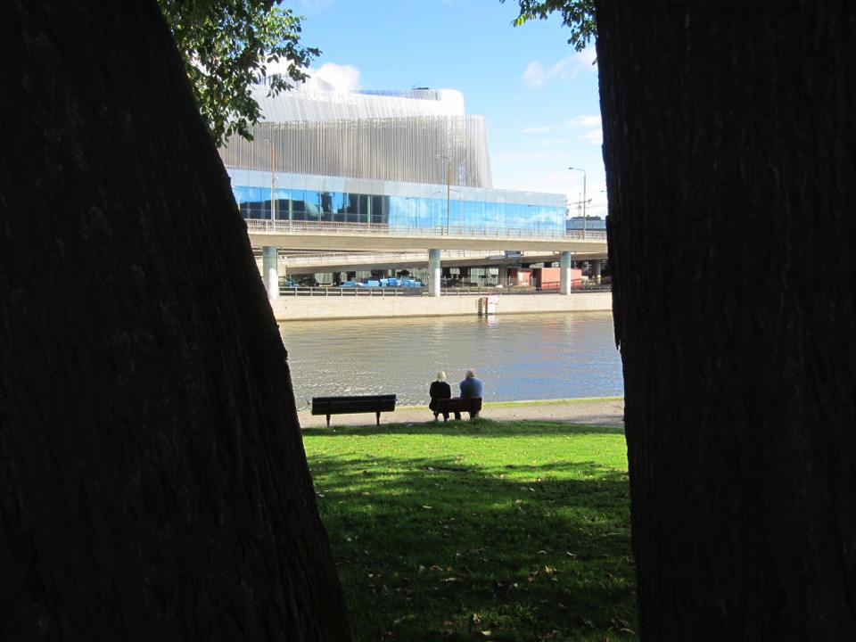
Not this.
This is dumb.
föregångslandet

Slide 50
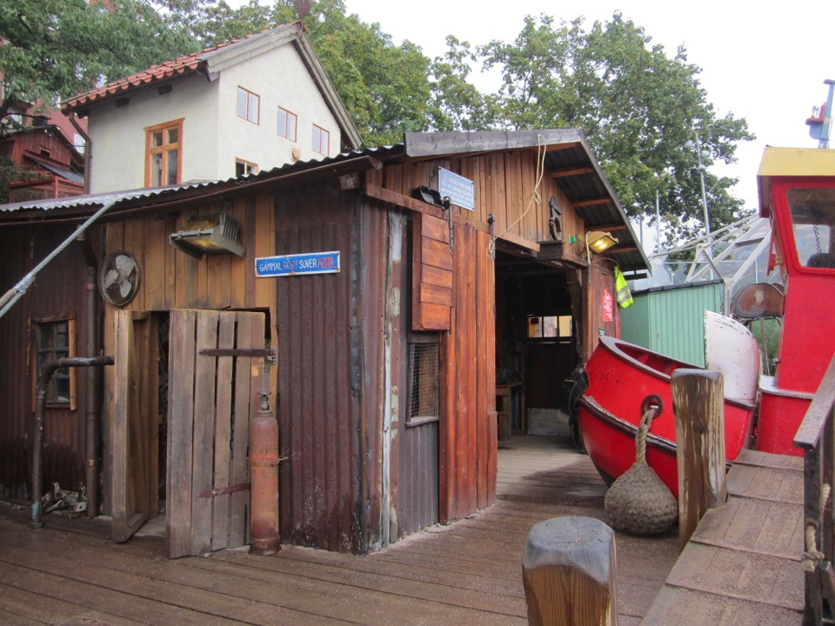

Slide 51
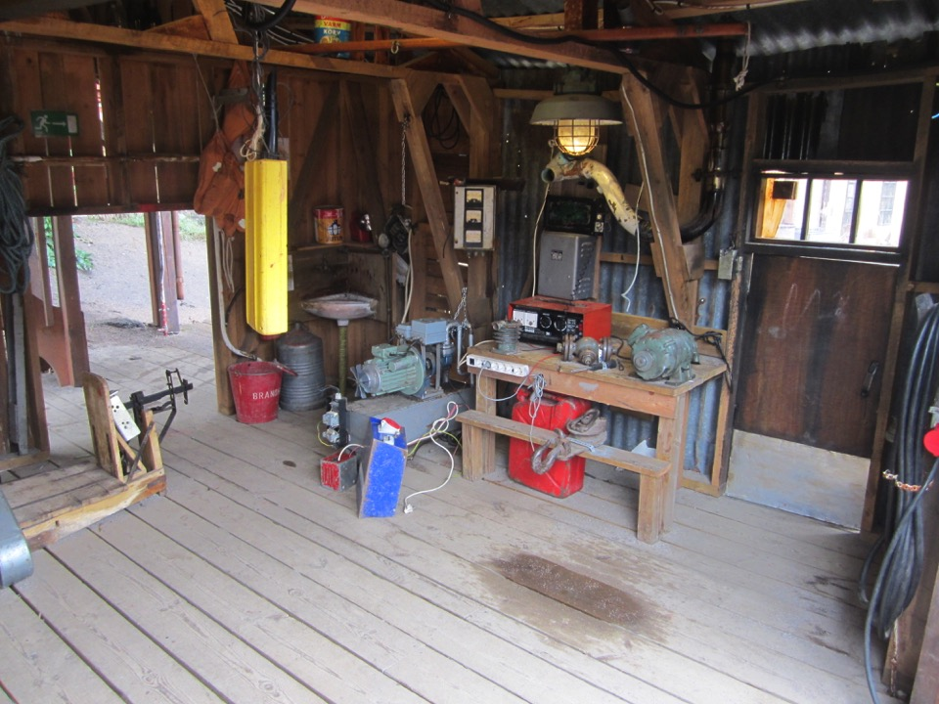

Slide 52
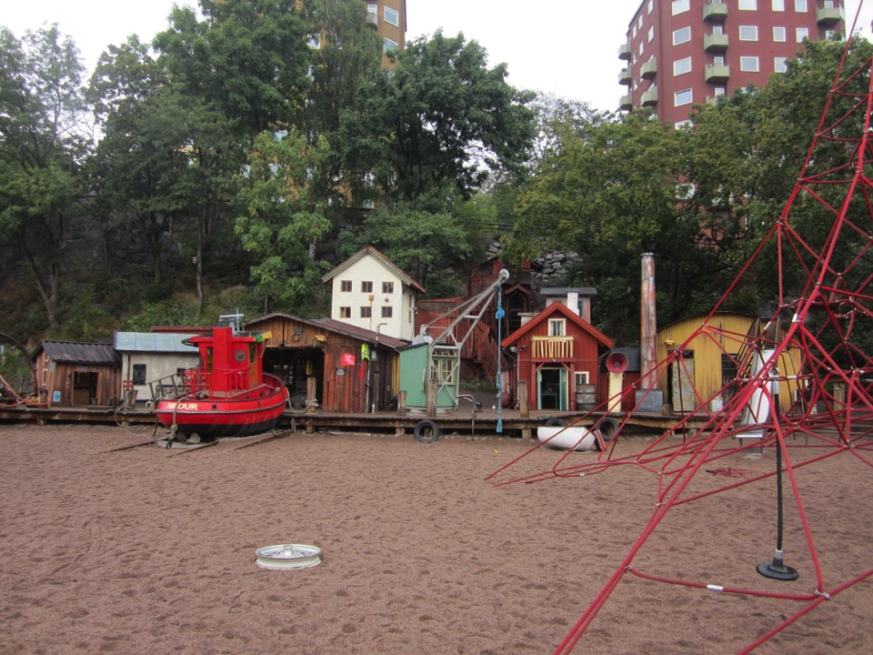

Slide 53
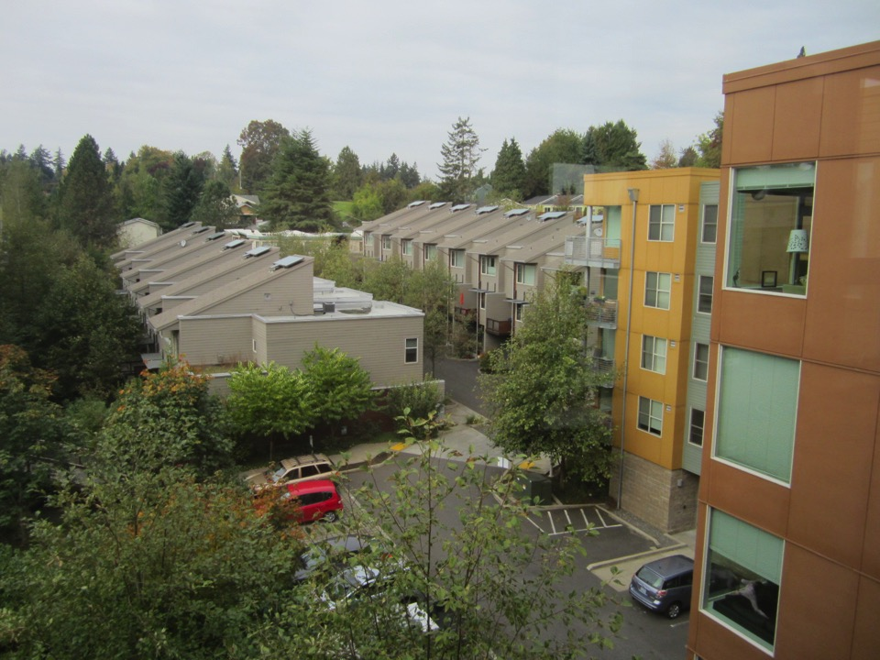
Portland pictures

Slide 54
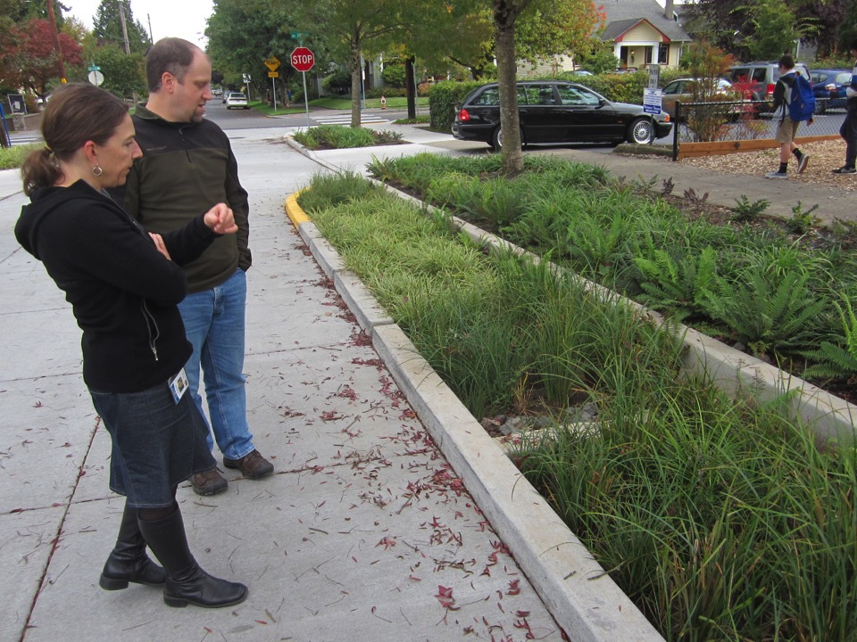
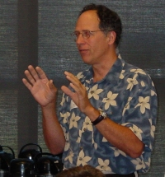
Portland pictures
‘Green Streets’, Portland, OR, USA [inset Tom Liptan]

Slide 55
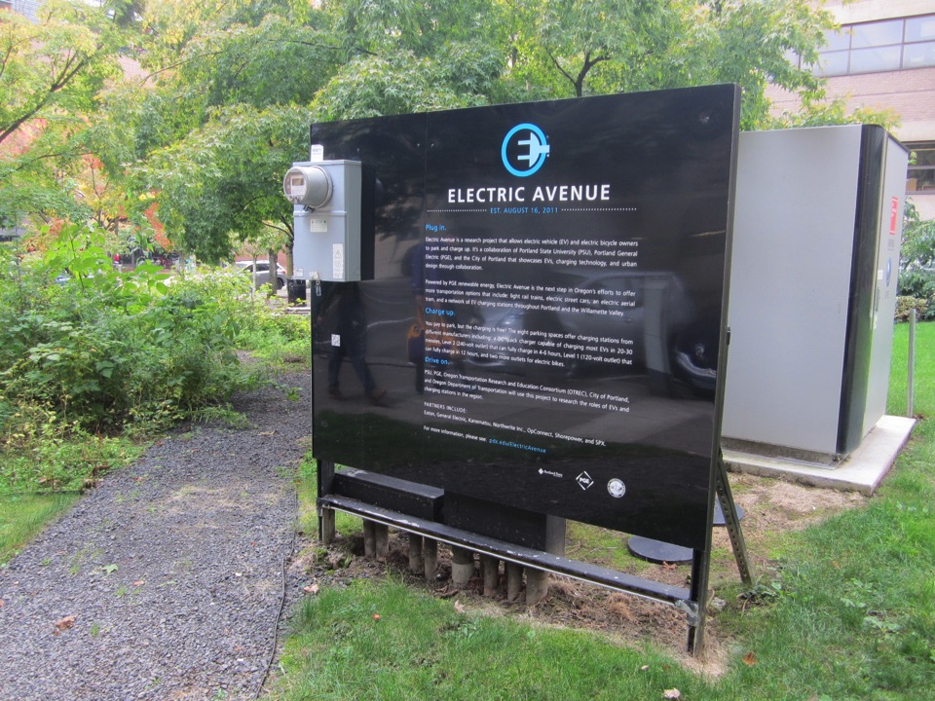

Slide 56
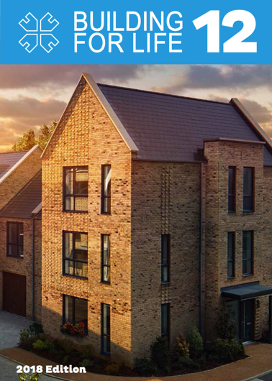
Smart places are built for life

Slide 57
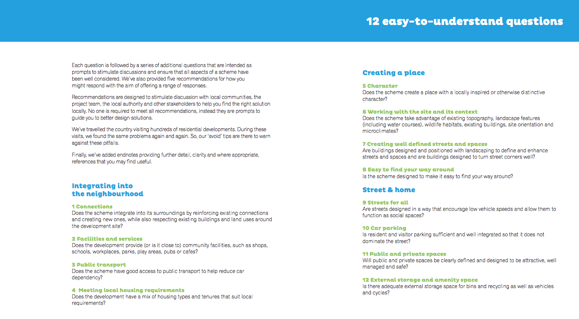
Smart places are built for
life

Slide 58
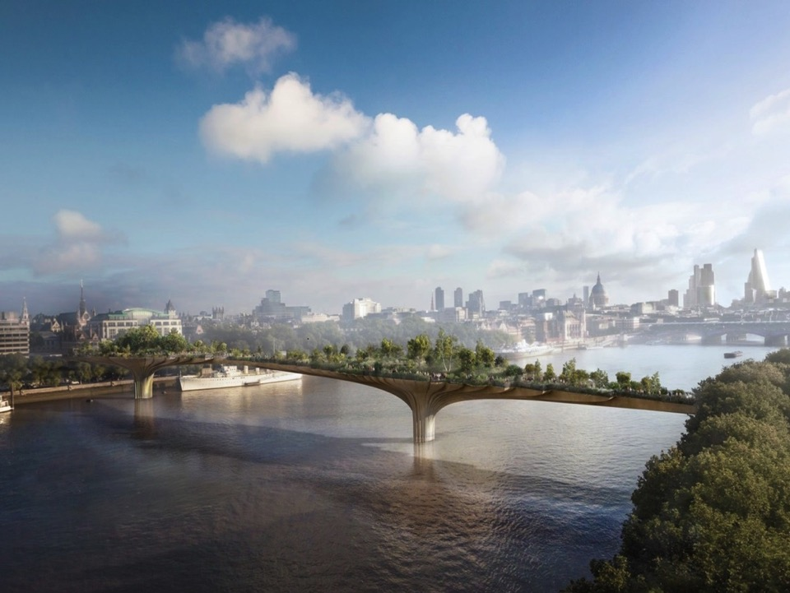

Slide 59
Celebrate their context
Integrate ecology
Design with water
Encourage active lifestyles

Slide 60
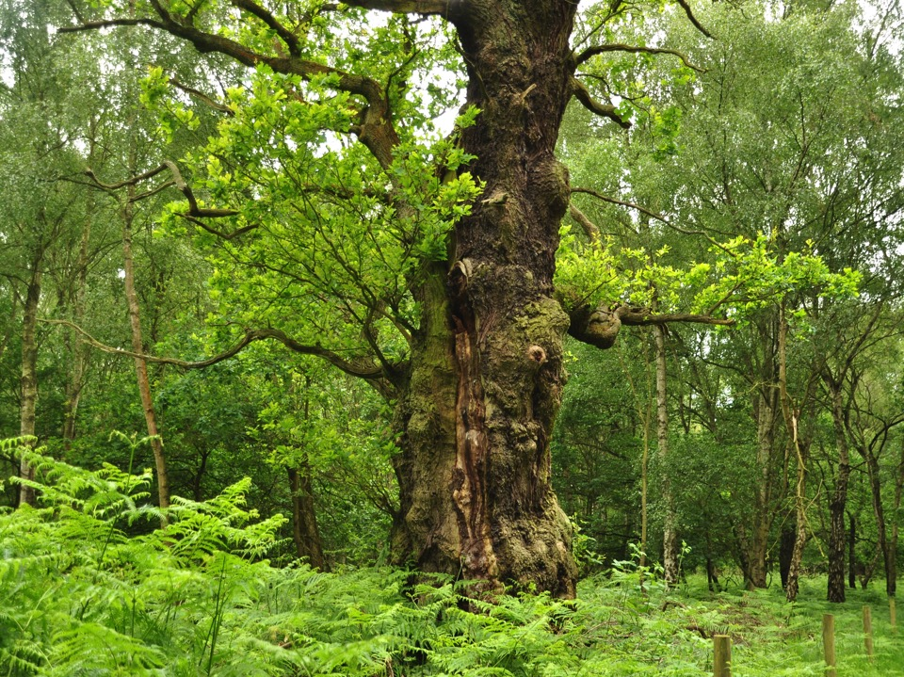

Slide 61
Celebrate their context
Integrate ecology
Design with water
Encourage active lifestyles

Slide 63
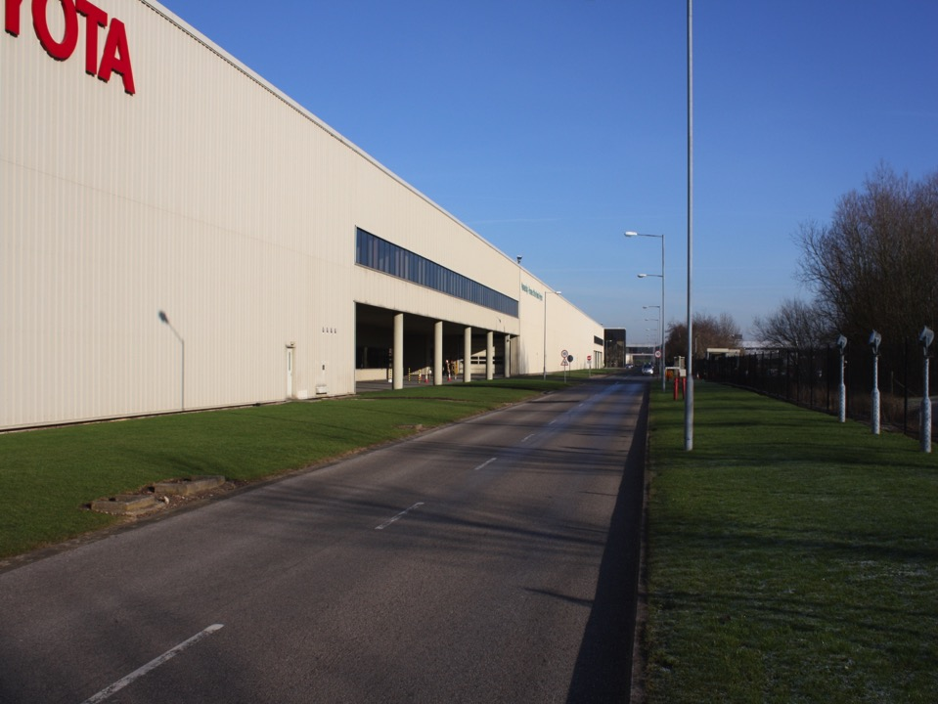

Slide 64
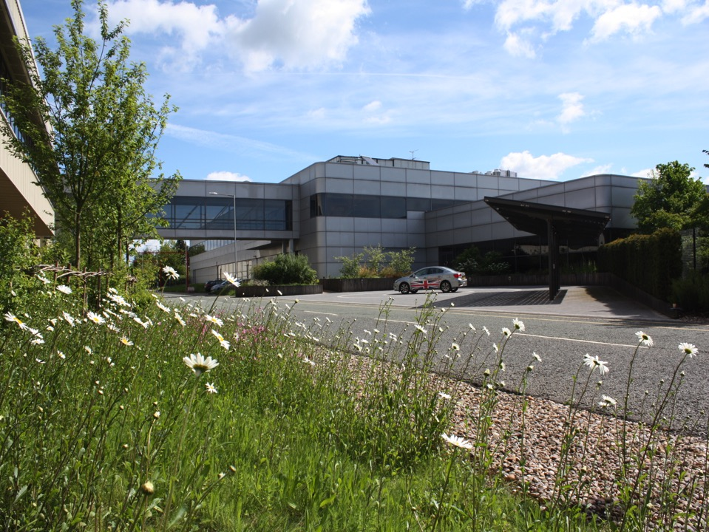

Slide 65
608
2
(Derbyshire Wildlife Trust)

Slide 66
Celebrate their context
Integrate ecology
Design with water
Encourage active lifestyles

Slide 67
Birkett House School Rain Gardens - Wigston, Leicestershire, UK

Slide 69
CIRIA SuDS Manual 2016

Slide 70
19 March 2019

Slide 71
Celebrate their context
Integrate ecology
Design with water
Encourage active lifestyles

Slide 73
Beware of
‘stuffscaping’

Slide 77
David Singleton
dsa-ed.co.uk

