Slide 1
Design Quality – The Smart Place Component
Jon Sandford Planning, Enabling & Development team
Mansfield Council Developer Forum
October 2019

Slide 2
Government Key Objective - 'fix the broken housing market‘
#WeAreHomesEngland
Four key objectives for MHCLG - .. And so for Homes England …
… and a clear view that Homes England must play a critical role in delivering this change in the market
More land for homes in the right places
"Fix the broken housing market"
Build homes faster
An aspect of which may be delivering “smart places” … ?
Diversify the homebuilding market
Improving access to and experience of the housing market

Slide 3
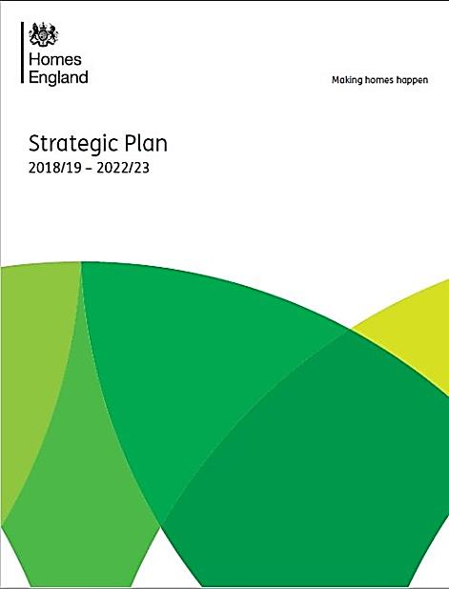
“The new Homes England is all about making homes happen – and our new five-year plan sets out our ambitious new approach. We are committing to boosting housing supply, productivity, innovation, quality, skills and modern methods of construction to help make a more diverse and resilient market.”
Nick Walkley
Chief Executive, Homes England

Slide 4
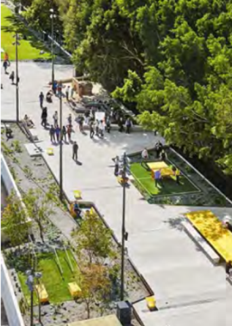
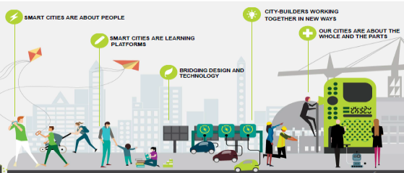
From Smart Cities to Smart Place
Smart Place –
Six Pillars (IBI)
Energy and Env
What is Smart Place?
Why Smart Place?
Who is involved?
When should we respond?
Where is it relevant?
How to progress?
Economy
Smart
Living
Smart
Places
People
Governance
Travel
and movement
Notes:
What is Smart Place -
Smart city concepts at the site spatial scale
IBI six pillars / Arcadis pillars
Multi-faceted concept
Two layers at a site – the digital layer (user interface / apps & digital twin) / new physical infrastructure – Handforth matrix of opportunities
Spatial scale of implementation
Temporal timescale of implementation
Why Smart Place -
Site competitiveness / resilience / saleability
Link to / comply with NPPF sustainability and resilience policy …
Who is involved -
Site stakeholders / the Councils / Smart city experts / Tech providers / the University sector … Homes England as facilitator
When should we respond –
An opportunity now to respond to the emerging agenda – to create best practice – to create the innovation curve.
Where is it relevant –
All sites – All homes – emphasis on large sites?
Varying spatial scales of implementation – the home / the street / the district centre / the public realm / greenspace / the whole site / beyond the site.
How to progress –
No defined / mandatory process –ie; in the planning system other than resilience / sustainability
Market and demand led through the competition / sales argument – responding to end user demand
Stakeholder buy in and engagement – focus groups to test demand
Academic Uni sector involvement – Living Lab concepts
Emerging planning process and delivery through Homes England facilitated projects.

Slide 5
Design Quality – The Smart Place Component
Smart Place –
Six Pillars (IBI)
BfL12 context
Smart place - smart city thinking at the site scale
Enhance site competitiveness, sales, delivery
Six themes – interventions over time and spatially
A new component in the master-planning process …
Emerging design and enabling area for Homes England
Partnership / collaborative working
Developing methodology – several pilot projects
Links with the MMC process …
Energy and Env
Economy
Smart
Living
Smart
Places
People
Governance
Travel
and movement

Slide 6
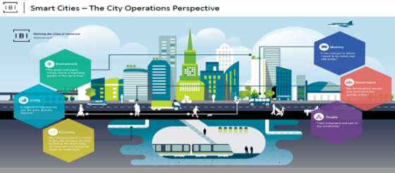
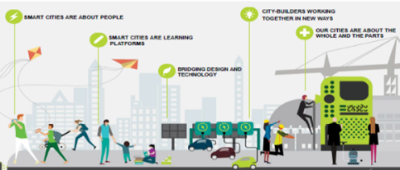
Smart Place – Challenges
Multi-disciplinary / multi-perspective approach required.
Embrace all built environment components
Project identification easy – delivery and funding challenges.
Continually evolving technology landscape
5 year time horizon – uncertainty beyond – strategy resilience
Expertise in short supply
Notes:
The design approach will be multi-disciplinary / multi-perspective - involving the key built environment disciplines in design and engineering and planning; but also involving disciplines from the technology sectors.
The project will aim to identify deliverable projects for the site; and tee up delivery conversations - practical project delivery will be a next phase / stage in the process beyond this project.
The technology landscape is evolving and changing - solutions identified now will have a limited shelf life - there is acceptance that technology solutions over the life of the development will evolve over time; thus requiring a future ready / resilient / adaptation facilitation approach to the design of the site and associated facilitating infrastructure and solutions.
The focus for solutions and technology interventions will be within the bounds of the site, within the next 5 years - however linkages and synergies with solutions outside the site and beyond 5 years will recognised and identified - as potential interventions beyond this project.
Potential technology projects will embrace all components of the urban fabric in the road corridor within a defined and agreed boundary - inclusive of greenspace / public realm / the street / individual properties.
Knowledge and expertise relating to the delivery of Smart Place interventions is evolving, fragmented and will need to be brought and applied to the project situation.

Slide 7
Smart Place Planning Skills and Stakeholders
Statutory / Government departments / agencies
DfT
Highways England
BEIS
Homes England??
Local authorities
Utilities providers
Academics / education
End users / future users / Community
Technology developers
Land developer / commercial
Intelligent transport systems GIS Data Analysts
Masterplanning / urban design
Landscape architecture
Technical partner (e; CISCO, Node, IBM, University)
Engineering (M&E, drainage, transport, waste, energy
Legal expertise
Economist
IBI very helpful so far in formulating ideas
Notes:
Statutory Enablers (e.g. EA, HE, UU, Cheshire CC, TfN, etc)
Administrative Enablers (e.g, LA, MHCLG, DfT etc)
Education establishments ( Salford / Manchester / Chester University)
Technical Enablers (e.g. infrastructure providers, prop tech innovators etc)
Commercial Enablers (e.g. house builders, developers, investors, landowners etc)
Community Enablers (e.g. community groups, students, education etc)

Slide 8
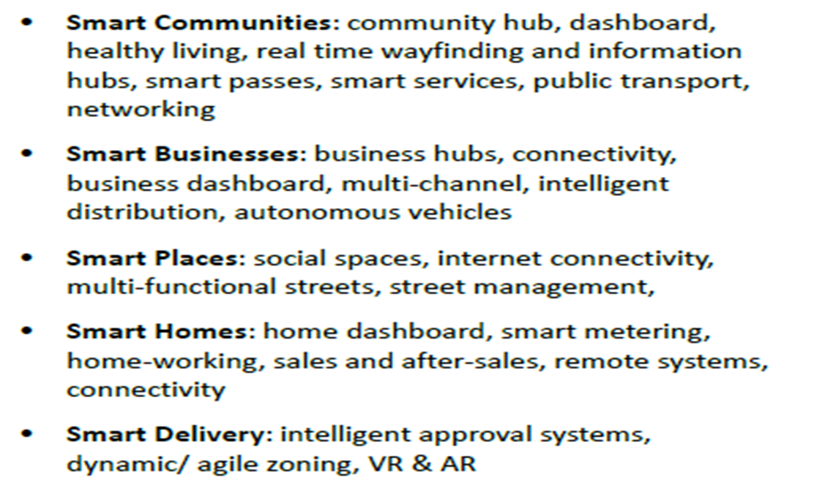
Relevant Tech Categories for Housing Sites
Smart Place –
Six Pillars (IBI)
Energy and Env
Economy
Smart
Living
Smart
Places
People
Governance
Travel
and movement

Slide 9
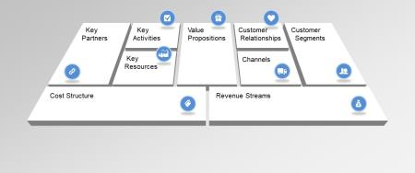
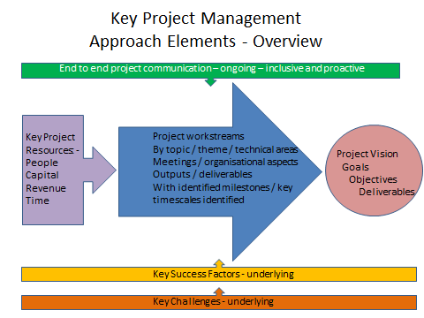
Smart Place - Key Success Factors
Stakeholder buy-in, collaboration and engagement
University sector input?
Keep commercial outcomes in focus – new business models
Tech provider engagement
Gloss on existing design vs DNA of the site design ?
Flexibility and shelf life factors
Resourcing and project management
Notes:
Engage a wide range of stakeholders with relevant technical expertise, opinion and perspectives that can add value to the outcomes.
This potentially involving input from appropriately experience consultants and the University sector Ensure the Smart Place plan has buy-in from the relevant stakeholders.
Clear and agreed objectives and intended outcomes.
Build on existing design thinking where relevant – Responsive approach vs Affect the design from the outset – the DNA approach.
Consider the various dimensions of Smart Place technology introduction - in terms of spatial scale; and temporal duration / timeframe.
Acknowledge and plan for smart technologies to have a finite shelf life - building in appropriate future proofing and resilience to the strategy of technology intervention.
Recognise and respond to new and emerging technology intervention business models - in understanding how interventions may be introduced to the site
Allocate concerted resources to the Smart Place Masterplan project - within the Council.
Appropriate consultancy fee and capital resources to fund the design and ultimately the deliver of the Smart Place Masterplan.
Adopt and apply a project management approach to the delivery of the Smart Place project.
Consider a "living lab" approach to the application and monitoring / learning from the introduction of the technologies at the site; in conjunction with the University sector Co-production and delivery of the Smart Place Masterplan project and process between the Councils / key stakeholders / Homes England.
Clear communication and assimilation of the Smart Place Masterplan design process. With the design team, with stakeholders, with the affected communities / potential end users.
Recognition of synergy between interventions within the site and those that may arise outside the site..
Build on the experience from other Smart Place Masterplan projects

Slide 10
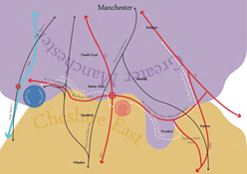
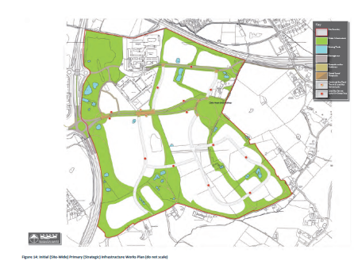
Smart Place – Homes England Enabled Projects
Homes England position
Homes England enabling role
Live projects -
Handforth Garden Village
Huncoat former Housing Zone
Tresham Garden Village
Northern Gateway Rochdale
Others in the pipeline …
Notes:
Other Smart Place Masterplan Projects in the Pipeline –
Stockport West Smart Masterplan
Lincoln Western Growth
Longcross GV
Dunton Hills GV
Burgess Hill
Less traction / interest
Whittingham Hospital

Slide 11
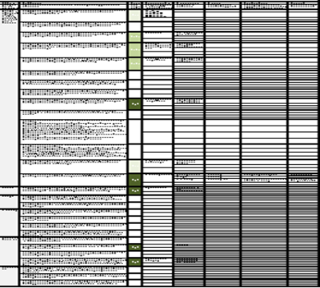
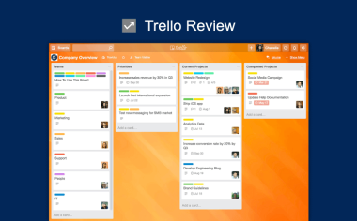
Smart Place – A Planning Process
Handforth GV precedent case
Input resources
Universities involvement
Grounded in existing masterplan
Project work-streams and comms
The process so far …
Process future developments
Notes:
Input resources –
Council time in facilitating and project managing the Smart Place project.
Homes England time in facilitating the Smart Place project - Jon Sandford.
Secure and assign multi-disciplinary design team input and fee - May be circa £Xk taking the Handforth case as a benchmark.
Multi-disciplinary design, technology and engineering skills - working in a holistic way - potentially utilising consultancy input.
Developer / landowner input.
Technology provider input Council stakeholder input - political members / community / cross-Departmental input
Academic sector / University input.
Workstreams -
Identify, invite, manage, engage with key stakeholders
Initiate and develop conversations with potential technology providers / agents for delivery.
Initiate and develop conversations and involvement with the Academic sector
Detailed Smart Place Masterplan brief writing; identifying key outcomes and outputs - Handforth case as a precedent
Secure buy-in of key stakeholders to the process
Consultancy input procurement
Collation of relevant background data and contextual information.
Assimilation and review of the existing masterplan context - Identify the relevant policy and vision themes for the site to align to Smart Place interventions - so creating the grounding for the Smart Place Masterplan formulation.
Review, scope and consider potential technology interventions to feed into the workshop process; and understand / review potentially new business models that may underpin the interventions.
Design and delivery of the Smart Place workshop programme Scanning and aligning the project and site towards funding for technology delivery - ie; with Innovate UK.
Review and consider physical change and implications for the layout of the site - feeding back into the masterplan design
Review and assimilation of Smart Place workshop design process outcomes - into Smart Place design process reports.
Scoping and framing "living lab" projects arising from the Smart Place Masterplan outcomes.
Scoping and framing and open invitation process - relating to the preferred / immediate technology interventions identified.
Review and continual learning from the project. Smart Place commission project management.
Communications -
Steering Group Meetings - With / between key stakeholders, as above - at least on a monthly basis.
Weekly project management updates - emails and telecoms - with / between core Council team.
Weekly progress updates from the consultant team to the Council client.
Process so far
Flow diagram
Appraisal / review matrix spreadsheet
Baseline preparation
Foresight activity …
Spreadsheet framework
- Matrix dimensions - Site objectives vs smart factors -
Relevance
Application of smart
Specific smart interventions
Timescale
Enabling actions
Responsibility
Process future developments
Alignment with / shadow Smart Place BfL12 process – requiring developer Smart Place audit / review for the site as part of the planning application / consenting process.
Template Smart Place Plan – aligned with Travel Plan type requirements – having teeth ? …
This aligning with a proposed developer Smart Place Package now – and allowing for future evolution in the future.
Framing typical S106 and Planning Conditions requirements
Template Smart Place Handbook formulation
Open invitation process to develop tech delivery partner interest / relationships / new business models for delivery.
Development of community of best practice of Smart Place Planning – GVT Network
Digital twin concept development – interfacing with sales process / MMC process / user operations / site operation data and value capture.

Slide 12
A Potential Smart Place Design Process
Baseline / review work
End user focus group engagement
Tech partner engagement
Future scenario planning
Tech options developed / evaluated / selected
Detailed business model development
Tech option delivery process / plan
Integration and iteration with masterplan development and planning process

Slide 13
The Smart Place Healthcheck Workshop - Sequential Process
Foresight Review Tech by Theme
Review Site Objectives
Identify Smart Applications by theme
For Key Objectives
Consider Implementation
Lead into Tech Delivery Conversations
Connect Themes with Site Objectives
Consider spatial scale
Enabling Actions
Timescale
Responsibility
RAG rate objectives by themes.,,
Real time data capture
Real time data capture
Real time data capture
Notes:
Relevance
RAG rating for overall applicability.
Application of Smart
What is the applicability of smart that could impact on delivering the site objectives.
Smart Interventions
Proposed smart interventions
Timescale
when will the activity need to happen?
Enabling Actions
How will the intervention be applied to the place, including what the intervention means for the master plan?
Responsibility
Who will drive forward the intervention?

Slide 14
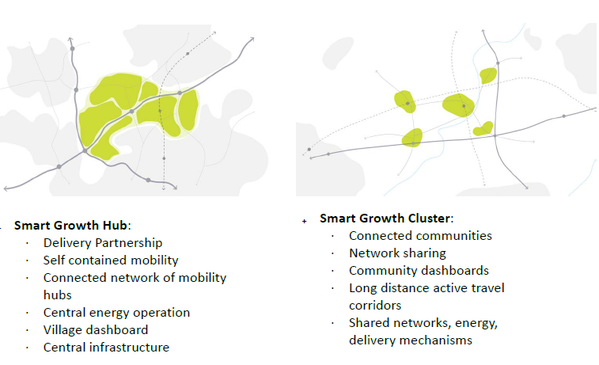
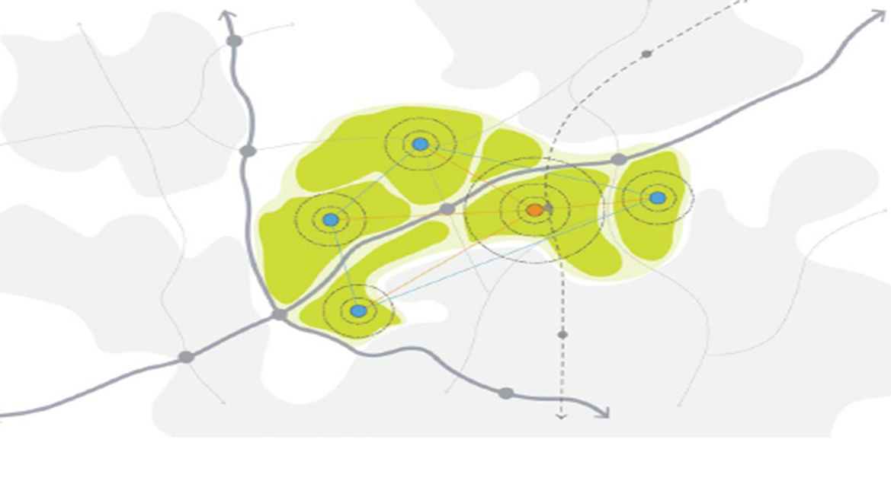
Possible Spatial Application / Implications
A Series of Connected Communities / Hubs ?

Slide 15
The Handforth Smart Place Demonstrator Ongoing Transferable Outcomes …
Formulate transferable process and method in the masterplanning of other (strategic growth) sites Cheshire and beyond.
Consultancy – smart place masterplanning work defined
Complementary to existing / previous masterplanning
Tech company partnering process established
Defined solutions delivery process
Development of a tech solutions transactions / marketplace / platform

Slide 16
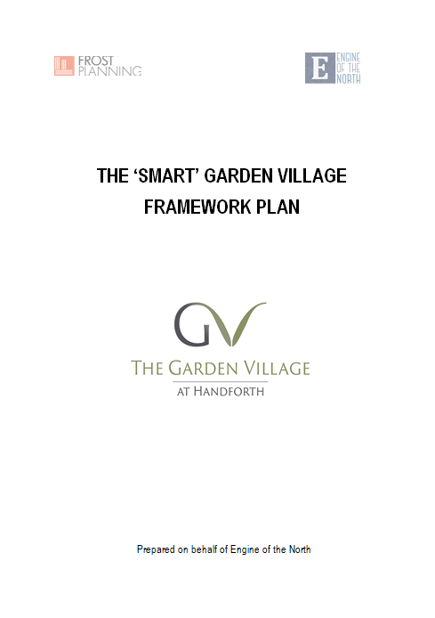
Developing Smart Place Plans (Frameworks) for Sites – (Reserved Matters) Commitment Statements
Set out the site context
Policy context – local and national
Define the need for the smart place plan
Define the objectives of the plan
Define the principles and project / intervention areas
Smart Mobility
Smart Nature
Smart Design, Energy and Construction
Smart Public Realm
Smart Ready
Smart Homes and Workplaces
Smart Safety
Smart Waste Management
Smart Community
Smart Commitments Statement
Require a response in development (reserved matters)

Slide 17
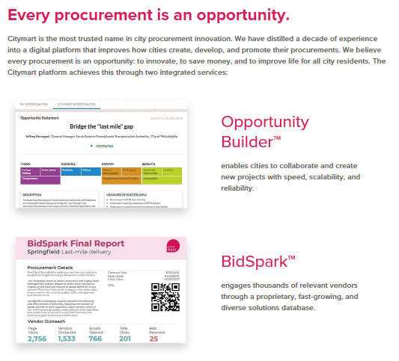
Delivering the Interventions …
Engage with project delivery partners
Open expression of interest events?
Connected Places Catapult / Tech UK
Website usage – Citymart
Commercially self sustaining project propositions?
New business models …
The value of data
Capitalising / collateral through the value of cost savings
Recycling data to aid community and site maintenance

Slide 18
The Digital Twin Concept and Link with MMC
Create the digital twin of the site
Site visualisation model
Site data capture platform
Links with MMC delivery …
Facilitate enhance sales
Enable housing unit customisation
Link to MMC production
Eg; Swan Housing

Slide 19
Smart Place - Next Steps for Mansfield?
A Smart Place Planning Exemplar Project …
Develop Smart Place planning expertise in the Council & collaboration
Potential project objectives
Create the context for smart place thinking
Work with Homes England in developing best practice
Help create a Community of Smart Place Practice
Notes:
Potential project objectives –
Assess, design, plan new technology for the built environment (Smart Place) interventions for the site.
Create a Smart Place Masterplan / Smart Plan that has buy-in from relevant stakeholders
Add value to the site proposals - through enhancing site competitiveness, saleability and resilience to future change - in line with developer commercial adv, Council and Government resilience and sustainability policy objectives.
Identify a defined and manageable number of smart place intervention projects that will be delivered at the site within the next 5 years Future proof / make the site adaptable and ready for - and prepare the site for the introduction of emerging and anticipated smart place interventions that may come forward in the medium to longer term.
Prepare for an open invitation to technology providers to bring Smart Place technology solutions to the site Establish relationships and contacts with technology providers able to delivery smart place interventions for the site.
Identify and confirm delivery (business) models / mechanisms / routes relating to the relevant Smart Place technology interventionist at the site.
Identify and scope potential Living Lab projects for ongoing academic sector involvement.

Slide 20
Questions and Discussion …

