Slide 1
Planning and Regeneration Update
Martyn Saxton
Head of Planning & Regeneration

Slide 2
Local Plan
  Examination on Publication Draft May 2019
  Consult on Modifications - Autumn 2019
  Adopt Spring 2020
Gypsy & Traveller & Travelling Showpeople DPD
  Consultation on 15 potential sites July / Sep 2019
  Next steps – Regulation 19 Consultation

Slide 3
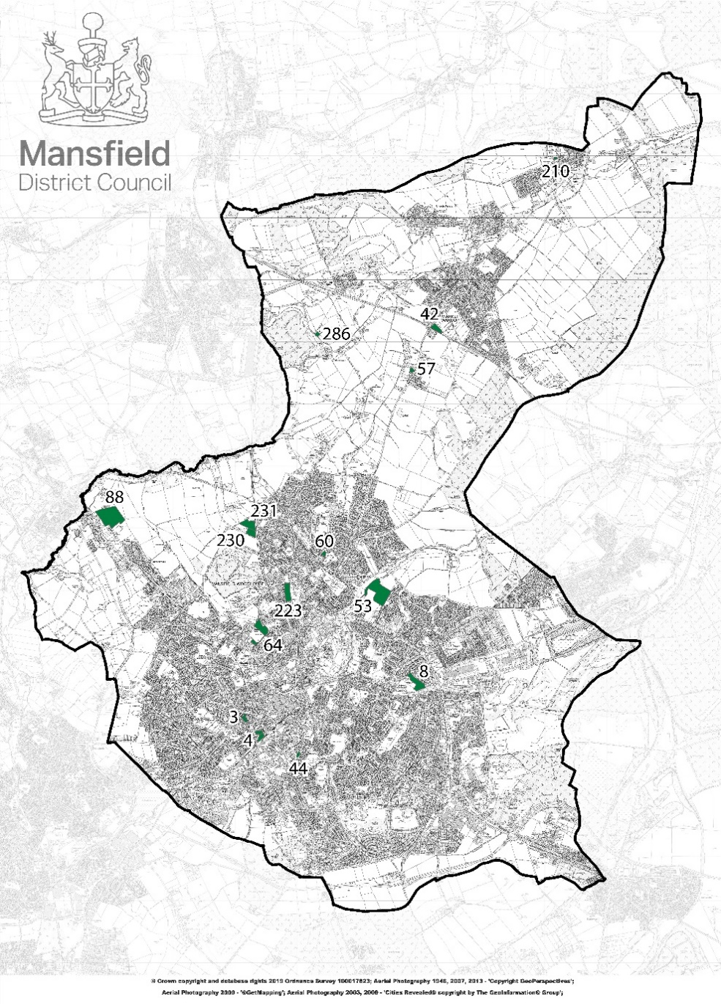

Slide 4
Town Centre Master Plan
- revitalise the town centre/visitor economy
- links to FHSF & Towns Fund
- evidence gathering
Future High Street Fund
- up to £25m from MHCLG - passed Stage 1
- investment in physical infrastructure
- acquisition of land
- improvements to transport access
- support for COU for housing
- March 2020 final submission

Slide 5
Towns Fund
  announced 6th September 2019
  £25m allocated (non-competitive)
  awaiting further details
  focus on improved transport, broadband connectivity, skills and culture
  funding aimed at areas with;
    lower income population in towns
    below national average productivity
    low skills attainment

Slide 6
Town Hall Refurbishment
  £1.4m scheme
  completion November
  2 offices units let
  retail unit under offer
  4 remaining units to be let

Slide 7
Mansfield Townscape Heritage Project
  £850k National Lottery Heritage Fund
  improvements/Renovate properties on Leeming Street/Market Place/Stockwell Gate
  grant panel set up
  launched on 3rd September 2019
  ends February 2024

Slide 8
Mayor’s Apprentice of the Year Award scheme for local employers taking on apprentices (CHAD Business Awards)
New Business Surgeries
  free support and advice
  initially 2 days per month & 5 slots per day
  business planning / sales / marketing
Brexit Business Readiness Events
Entrepreneurs Programme
  Workshops / network events / mentoring

